Slide 1
DEPA Project – Airline Analysis
Team 2
Ningxin Kong
Huaiyuan Fan
Xulin Chen
December 7th 2023

Slide 2
Agenda
Agenda
Introduction
Exploratory Data Analysis
Extraction, Transformation & Loading
Data Model
Business Use Case 1: Revenue Analysis
Business Use Case 2: Delay Analysis
Business Use Case 3: Accident Analysis
Conclusion

Slide 3
Problem Definition
Introduction | EDA | ETL | Data Model | Revenue Analysis | Delay Analysis | Accident Analysis | Conclusion
Business Problem
In the airline sector, large volumes of unprocessed data represent an untapped resource with the potential to enhance strategic decision-making.
Our objective is to derive insights from airline data and accident data in terms of analysis on revenue, delay, and accident data.

Slide 4



Business Case Overview
Introduction | EDA | ETL | Data Model | Revenue Analysis | Delay Analysis | Accident Analysis | Conclusion
Business Problem
Revenue Analysis: The focus is on investigating passenger booking patterns, and understanding the revenue trends for different aircraft models, routes, and fare types. Insights derived can optimize decision-making processes for flight routes.
Delay Analysis: The focus is on trends in flight performance, such as delays for different airports, operators, etc. Stakeholders can make more informed choices to enhance efficiency, reduce costs, and identify relationships between delays and potential safety risks.
Accident Analysis: The focus will be evaluating flight performance with respect to accident frequencies of different aircraft types, operators, location, routes, etc. The team aims to derive insights for safety enhancement and risk mitigation.

Slide 5





Tools
Introduction | EDA | ETL | Data Model | Revenue Analysis | Delay Analysis | Accident Analysis | Conclusion
Business Problem

Slide 6
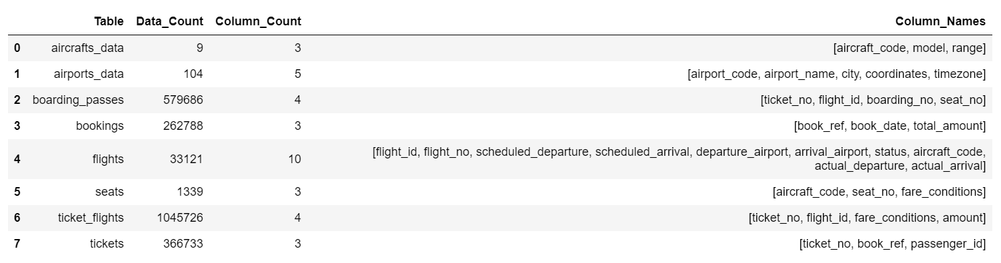
Airline Dataset: Data Source & Shape
Introduction | EDA | ETL | Data Model | Revenue Analysis | Delay Analysis | Accident Analysis | Conclusion
Airline operations and passenger data for analytics
Data Source: https://www.kaggle.com/datasets/saadharoon27/airlines-dataset

Slide 7
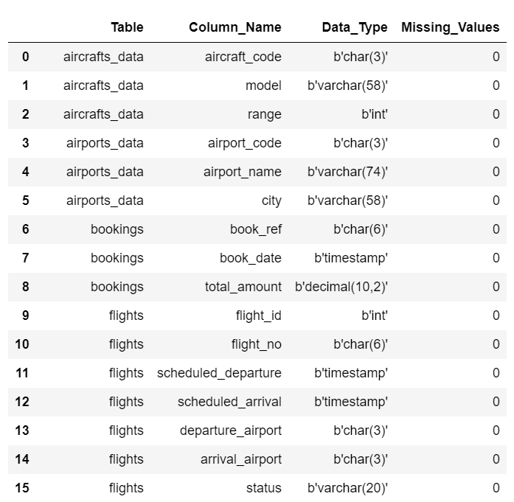
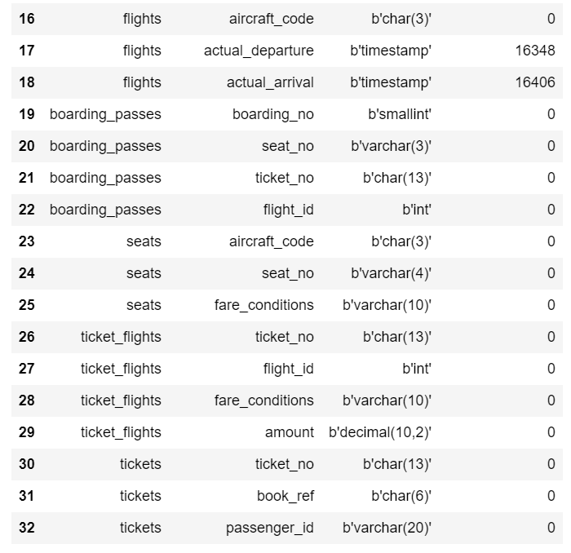
Airline Dataset Key Characteristics: Data Type & Missing Values
Introduction | EDA | ETL | Data Model | Revenue Analysis | Delay Analysis | Accident Analysis | Conclusion

Slide 8
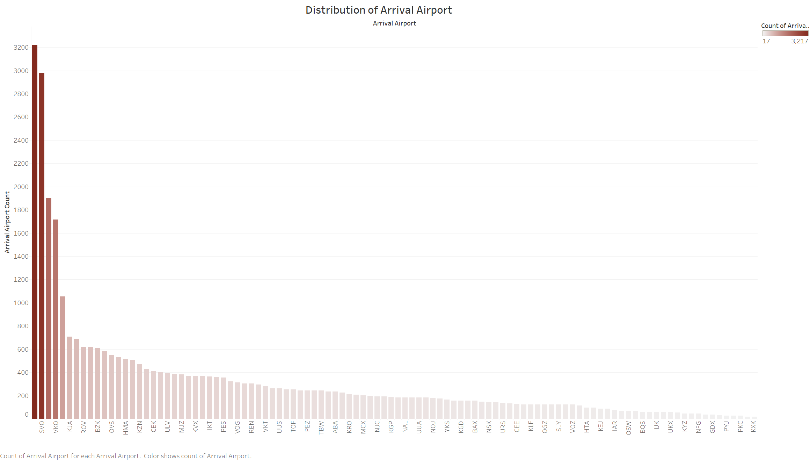

Airline Dataset: Arrival Airport Distribution
Introduction | EDA | ETL | Data Model | Revenue Analysis | Delay Analysis | Accident Analysis | Conclusion
TOP 3
DME (Moscow Domodedovo), SVO (Moscow Sheremetyevo Alexander S. Pushkin), LED (St. Petersburg Pulkovo Airport) have the most arrivals.
It’s extremely right-skewed since there is a small number of very busy airports.

Slide 9
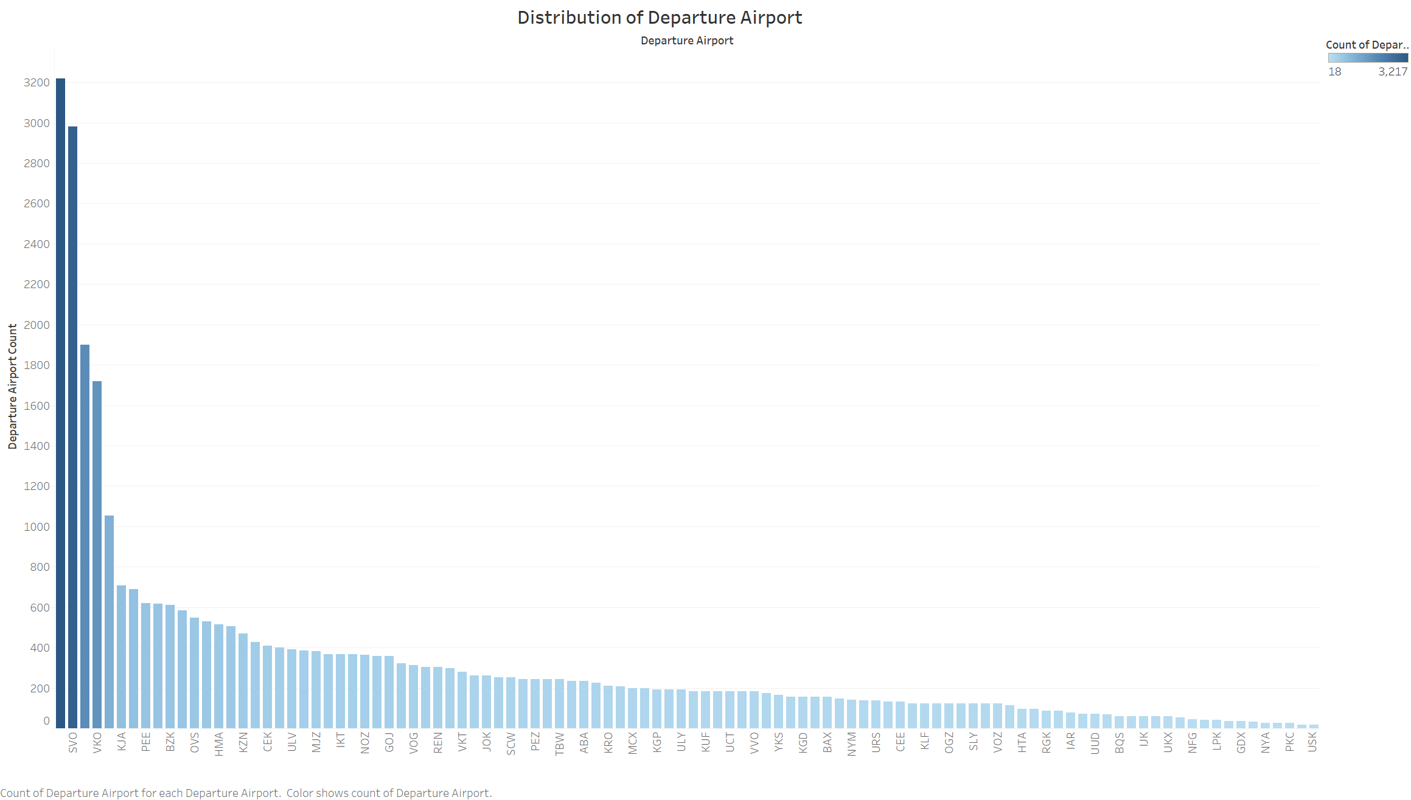
Airline Dataset: Departure Airport Distribution
Introduction | EDA | ETL | Data Model | Revenue Analysis | Delay Analysis | Accident Analysis | Conclusion
TOP 3
Similar to the arrival distribution, DME and SVO (in Moscow) and LED (in St. Petersburg) have the most departures.
Similarly, this is a very right-skewed distribution.

Slide 10
Accident Dataset EDA: Data Source
Introduction | EDA | ETL | Data Model | Revenue Analysis | Delay Analysis | Accident Analysis | Conclusion
Data Description: Worldwide accidents and hijackings involving airliners (12+ passengers), corporate jets and military transport aircraft since 1919.
Data Source: https://www.kaggle.com/datasets/deepcontractor/aircraft-accidents-failures-hijacks-dataset

Slide 11
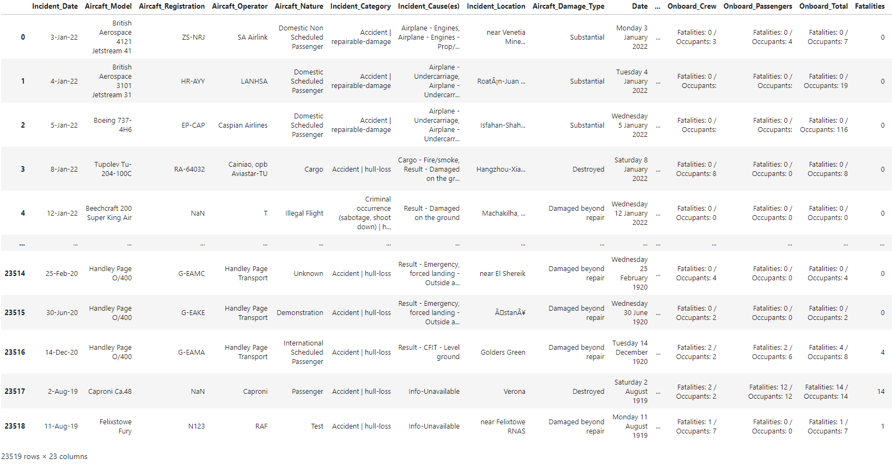
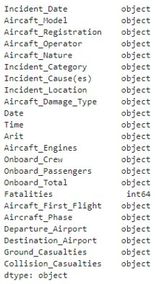
Accident Dataset EDA: Data Shape
Introduction | EDA | ETL | Data Model | Revenue Analysis | Delay Analysis | Accident Analysis | Conclusion
Count of Columns: There are 23 Attributes and 23,519 Records in the Accident Dataset and Datatype for all columns besides Fatalities (Int) are strings

Slide 12
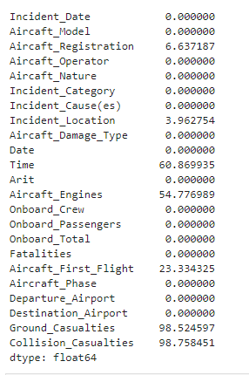
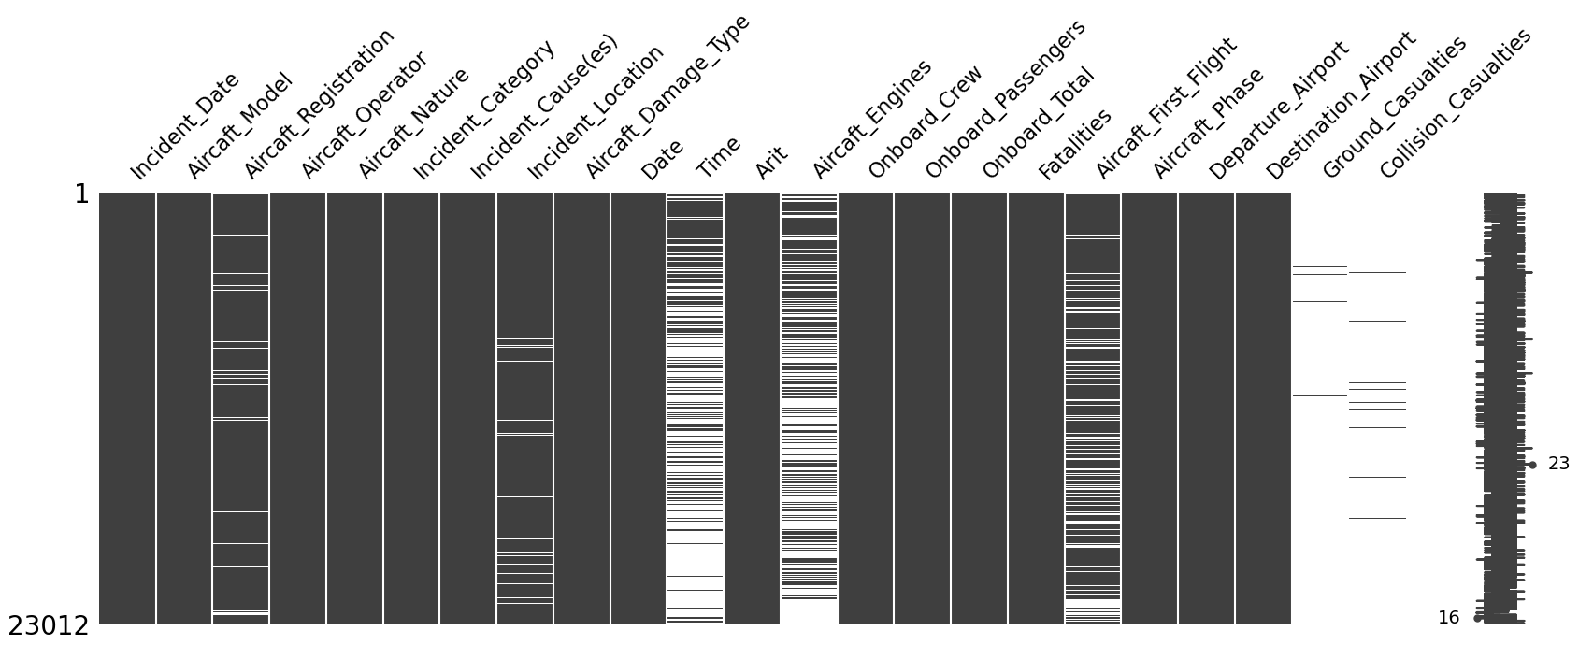
Accident Dataset EDA: Data Characteristics
Introduction | EDA | ETL | Data Model | Revenue Analysis | Delay Analysis | Accident Analysis | Conclusion
Data Completeness: 6 attributes have substantial null values
Missingno Visual
Null values (%) of each attribute

Slide 13
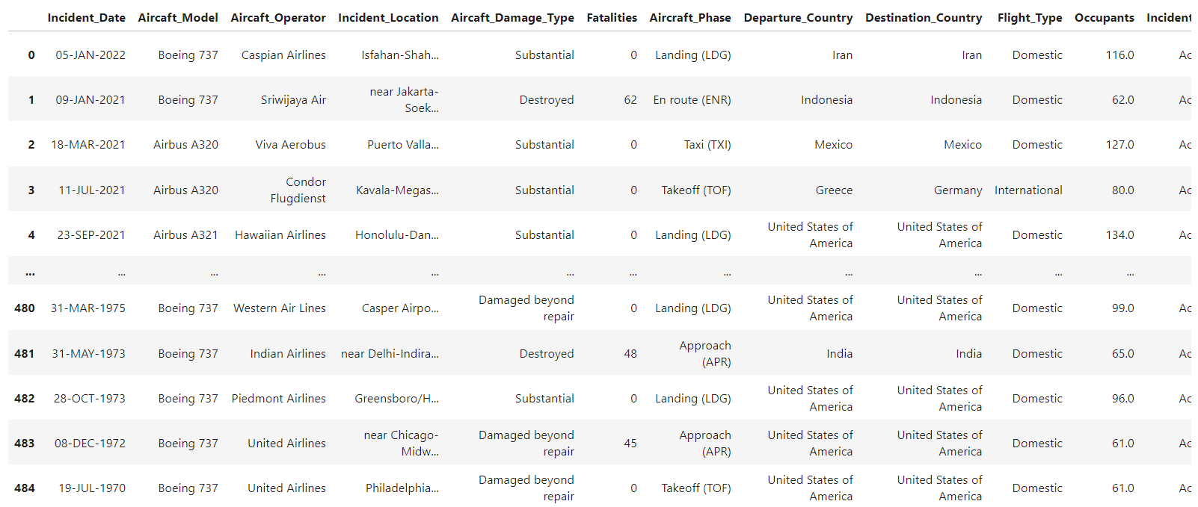
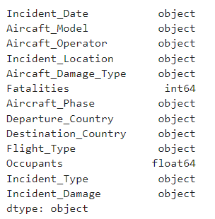
Accident Dataset EDA: Data Cleaning & Key Fields
Introduction | EDA | ETL | Data Model | Revenue Analysis | Delay Analysis | Accident Analysis | Conclusion
After removal of redundant attributes and attributes with substantial null values, Dataset contains 13 columns. 484 useful records remained to match with Airline Dataset records and analyze on commercial aviation records only.

Slide 14
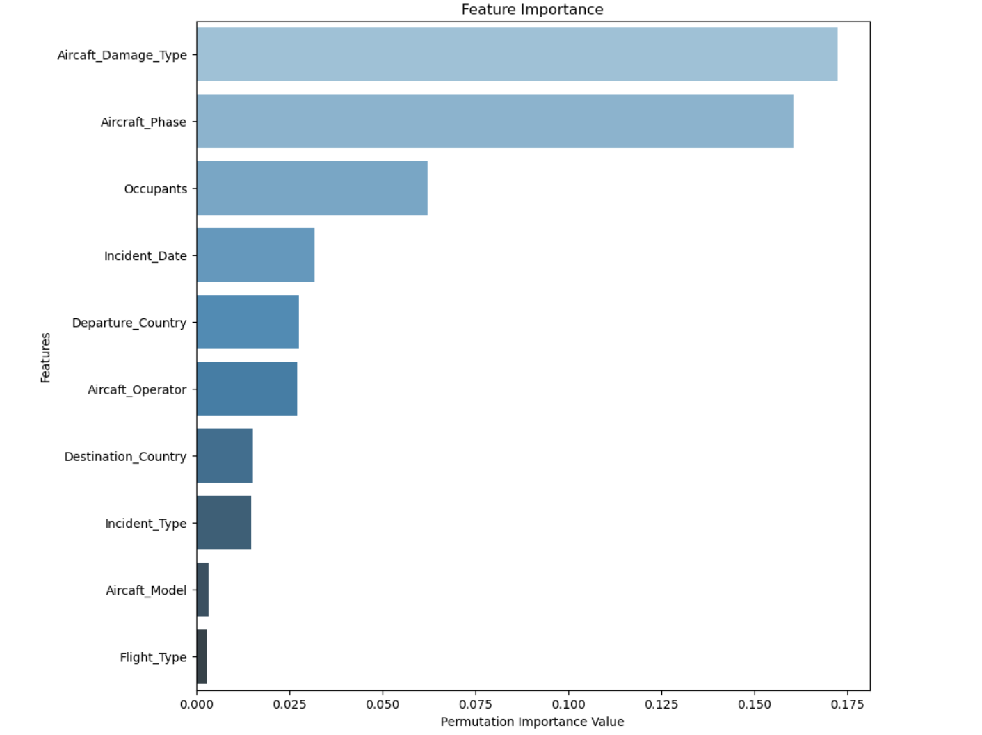
Accident Dataset EDA: Attribute Importance Level
Introduction | EDA | ETL | Data Model | Revenue Analysis | Delay Analysis | Accident Analysis | Conclusion
Feature Test indicates attributes that have high importance relation with accident fatalities:
Aircraft Damage Type
Aircraft Phase
Occupants
Incident Date
Departure Country
Destination Country
Aircraft Operator

Slide 15
ETL Overview: Data integrity, Compatibility, Relevance
Introduction | EDA | ETL | Data Model | Revenue Analysis | Delay Analysis | Accident Analysis | Conclusion
Data Model
Normalization
Variable Selection
Data Extraction
Airline Dataset: Imported 32 segmented SQL files into MySQL Workbench
Accident Dataset: Loaded 11 refined datasets into MySQL Workbench for analysis
Airline Dataset: Eliminated redundant coordinates and time zone columns from the dataset
Accident Dataset: Split to 11 normalized dataset
Airline Dataset: Edited SQL for MySQL and removed Russian terms from key columns
Accident Dataset: Filtered dataset for passenger flights and aligned with airline dataset specifications, reducing to 399 records in 13 columns
Airline Dataset: Transformed SQLite airline database into a SQL dump using Linux commends
Accident Dataset: Downloaded as a CSV and imported into Python

Slide 16
ETL Process: Airline Dataset
Introduction | EDA | ETL | Data Model | Revenue Analysis | Delay Analysis | Accident Analysis | Conclusion
Extraction
Source: SQLite database (109 MB)
Action: Converted to a 166 MB SQL dump (series of SQL statements) using Linux commands
Challenge: Size too large for MySQL Workbench
Solution: Split into 32 smaller SQL files
Compatibility Issue: SQL dump more suited for PostgreSQL
Adjustments: Manually edited SQL dump for MySQL compatibility (data types, syntax, constraints)
Data Cleaning: Removed Russian terms from `city` and `airport name` columns from 'airport dataset', `model` column from `aircraft dataset`; converted JSON to VARCHAR
Streamlining: Dropped `coordinates` and `time zone` columns from 'airport dataset', and `seats` table, to reduce redundancy
Transformation
Loading
Final Step: Loaded 32 converted and clean SQL files into MySQL Workbench for analysis

Slide 17
ETL Process: Accident Dataset
Introduction | EDA | ETL | Data Model | Revenue Analysis | Delay Analysis | Accident Analysis | Conclusion
Extraction
Source: Dataset downloaded as CSV
Action: Loaded into Python for processing
Data Cleaning: Removed columns with too many NULL values or were irrelevant to analysis (`Date`, `Arit`, `Aircraft Registration`, `Ground/Collision casualties`, `Time`, `Aircraft Engine`, `Incident Causes`, `Crew`, `Passengers`, `First Flight`)
Filtering: Kept only passenger flight records to align with airline dataset
New Columns: Added `Departure Country`, `Destination Country`, and `flight type` (domestic/international)
Data Alignment: Reformatted 'Aircraft Model' to match airline dataset
Enhancements:
Extracted 'Occupants' from `Onboard Total`
Split `Incident Category` into `Incident Type` and `Incident Damage`
Removed rows with 'Unknown' or NA values
Result: Reduced to 399 records across 13 columns
Transformation
Normalization
Organized data into 11 distinct datasets for clarity and structure
Loading
Final Step: Loaded all 11 datasets into MySQL Workbench for analysis
2 data sources will be connected using aircraft code column

Slide 18




Database Design: Key Considerations
Introduction | EDA | ETL | Data Model | Revenue Analysis | Delay Analysis | Accident Analysis | Conclusion
A relational database is chosen to be developed for our analysis.
Handling Complex Relationships
Clarity and Ease of Interpretation
The 2 data sources were originally meant for quite distinct purposes, resulting in complex relationships that a relational database can effectively .
The structured layout of relational databases, with data neatly organized in tables, rows, and columns, enhances interpretability.
Versatility for Broad Use
Efficiency through Data Normalization
A relational database’s ability to efficiently process diverse data operations makes it an adaptable and comprehensive solution.
By adhering to data normalization principles, our relational database minimizes redundancy and promotes efficiency and integrity.

Slide 19
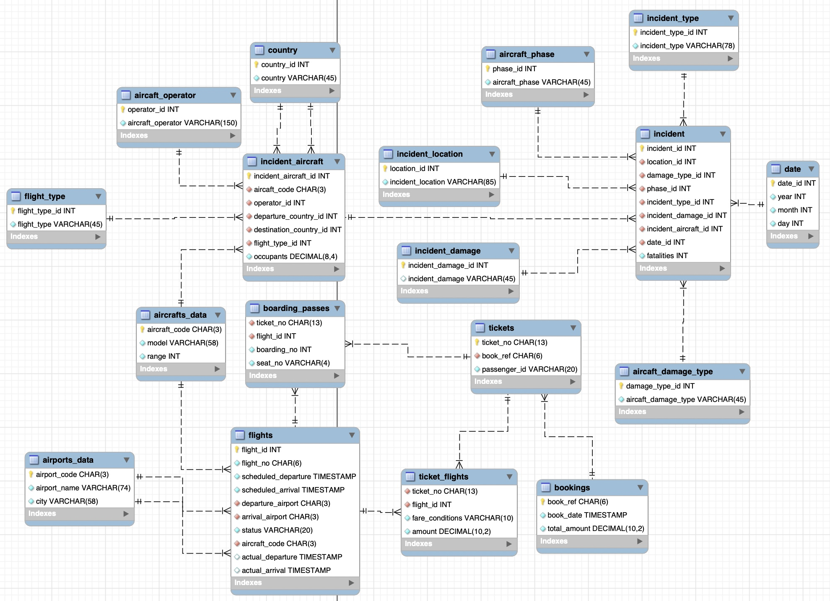
Database Design - EER
Introduction | EDA | ETL | Data Model | Revenue Analysis | Delay Analysis | Accident Analysis | Conclusion

Slide 20
Database Design Schema
Introduction | EDA | ETL | Data Model | Revenue Analysis | Delay Analysis | Accident Analysis | Conclusion
Table Name | Cardinality | Primary Key | Details
aircrafts_data | 1:M with 2 tables | aircraft_code | Connects the airline dataset to accident dataset; connects the incident_aircraft table and flights table using aircraft_code
flights | 1:M with 4 tables | flight_id | Connects to aircrafts_data, airports_data, boarding_passes, ticket_flights from the airline dataset
airports_data | 1:M with 1 table | airport_code | The airport_code attribute connects to both the departure_airport and arrival_airport in the flights table (Note: there are 2 1:M relationships. One is airport_code to departure_airport, the other being airport_code to arrival_airport)
boarding_passes | 1:M with 2 tables | Composite key: {ticket_no, flight_id} | A bridge table. Connects to the flights table using flight_id and to the tickets table using ticket_no
tickets | 1:M with 3 tables | ticket_no | Connects to boarding_passes using ticket_no, to the bookings table using book_ref, and to the ricket_flights table using ticket_no

Slide 21
Database Design Schema
Introduction | EDA | ETL | Data Model | Revenue Analysis | Delay Analysis | Accident Analysis | Conclusion
Table Name | Cardinality | Primary Key | Details
bookings | 1:M with 1 table | book_ref | Connects to the tickets table using book_ref
ticket_flights | 1:M with 2 tables | Composite key: {ticket_no, flight_id} | A bridge table. Connects to the tickets table using ticket_no and to the flights table using flight_id
Incident_aircraft | 1:M with 5 tables | Indicent_aircraft_id | Connects to country using departure_country and arrival_country, to aircrafts_data using aircraft_code, to aircraft_operator using operator_id, to flight_type using flight_type_id, to incident using incident_aircraft_id
aircraft_operator | 1:M with 1 table | operator_id | Connects to incident_aircraft using operator_id

Slide 22
Database Design Schema
Introduction | EDA | ETL | Data Model | Revenue Analysis | Delay Analysis | Accident Analysis | Conclusion
Table Name | Cardinality | Primary Key | Details
incident | 1:M with 7 tables | incident_id | Connects to date using date_id, to incident_type using incident_type_id, to incident_damage using incident_damage_id, to aircraft_damage_type using damage_type_id, to incident_aircraft using incident_aircraft_id, to aircraft_phase using phase_id, to incident_location using location_id
date | 1:M with 1 table | date_id | Connects to incident using date_id
flight_type | 1:M with 1 table | flight_type_id | Connects to incident_aircraft using flight_type_id
aircraft_phase | 1:M with 1 table | phase_id | Connects to incident using phase_id
aircraft_damage_type | 1:M with 1 table | damage_type_id | Connects to incident using damage_type_id

Slide 23
Database Design Schema
Introduction | EDA | ETL | Data Model | Revenue Analysis | Delay Analysis | Accident Analysis | Conclusion
Table Name | Cardinality | Primary Key | Details
incident_damage | 1:M with 1 table | incident_damage_id | Connects to incident using incident_damage_id
incident_location | 1:M with 1 table | location_id | Connects to incident using location_id
incident_type | 1:M with 1 table | incident_type_id | Connects to incident using incident_type_id
country | 1:M with 1 table | country_id | Connects to incident_aircraft using country_id (Note: there are 2 1:M relationships, one is country_id to departure_country, the other being country_id to destination_country

Slide 24
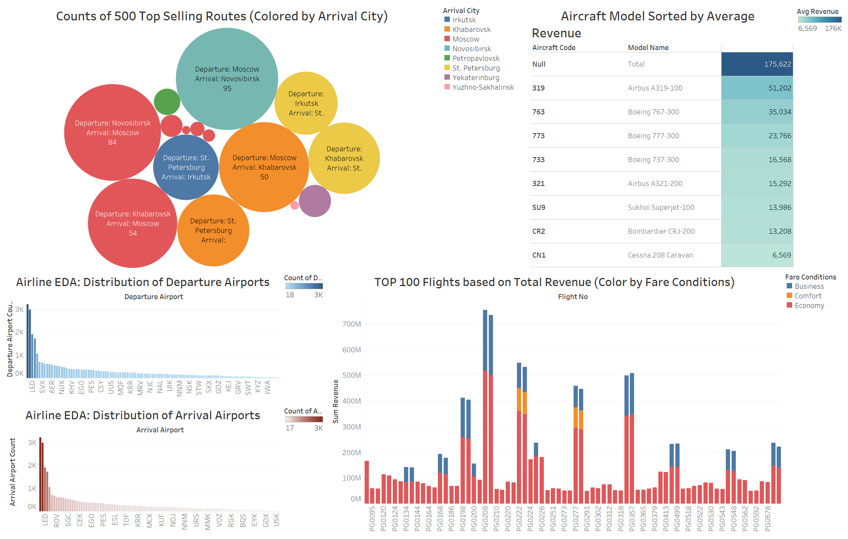
Business Use Case 1: Revenue Analysis
Introduction | EDA | ETL | Data Model | Revenue Analysis | Delay Analysis | Accident Analysis | Conclusion
TOP 3
Notes:
Airbus A319-100, Boeing 767-300, and Boeing 777-300 are the top 3 models in terms of average revenue.

Slide 25
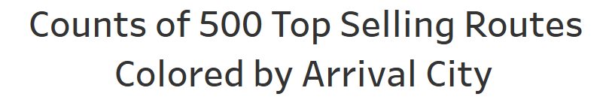
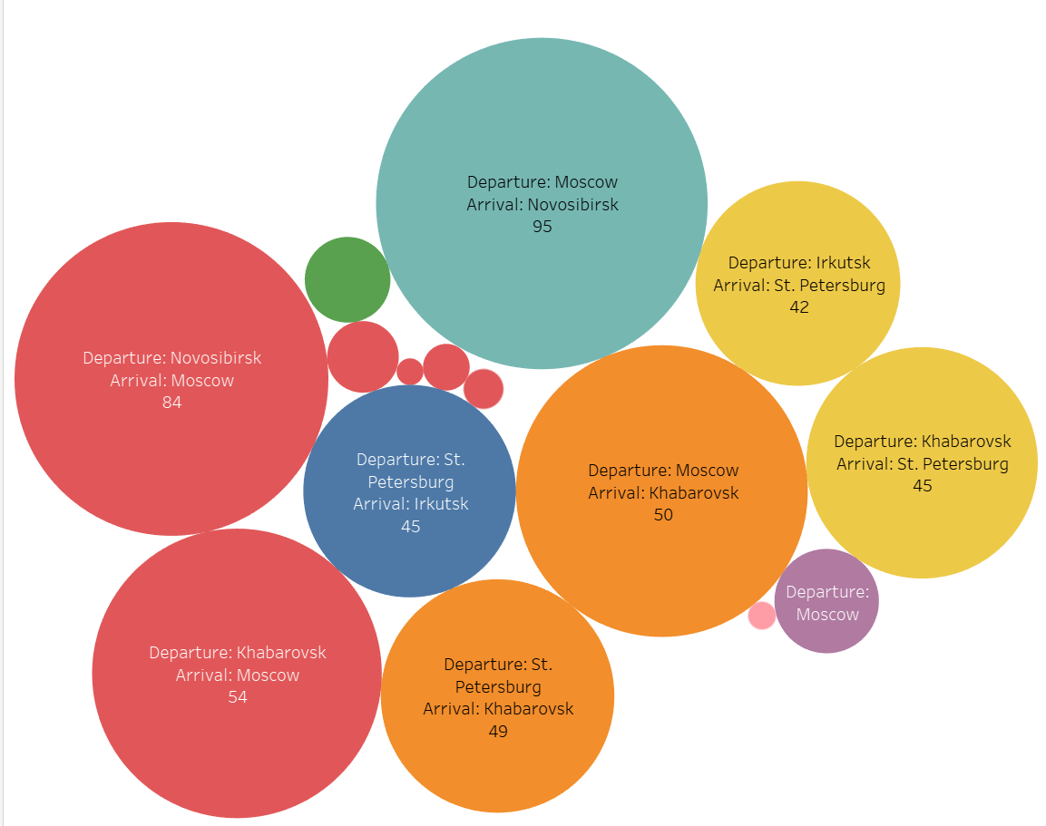
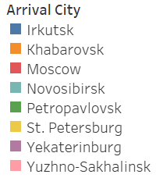
Business Use Case 1: Revenue Analysis
Introduction | EDA | ETL | Data Model | Revenue Analysis | Delay Analysis | Accident Analysis | Conclusion
Best-Selling Route (Total Revenue)
Moscow - Novosibirsk
flights make up 19% of the 500 top selling flights.

Slide 26
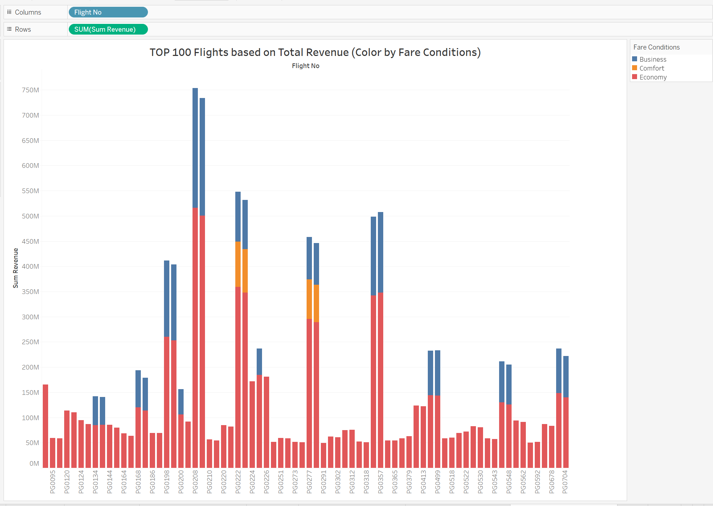

Business Use Case 1: Revenue Analysis Insight
Introduction | EDA | ETL | Data Model | Revenue Analysis | Delay Analysis | Accident Analysis | Conclusion
Economy tickets make up the majority of total revenue.
Flight PG0208 has the highest total revenue.

Slide 27
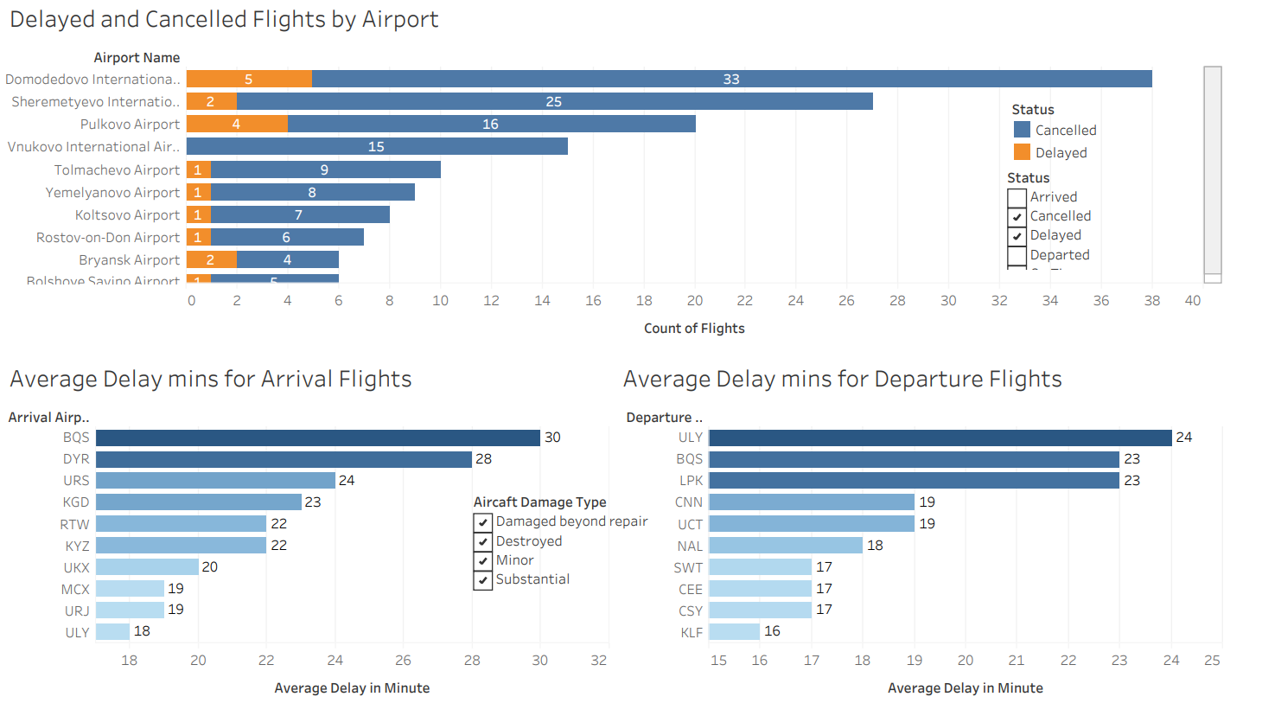
Business Use Case 2: Delay Analysis
Introduction | EDA | ETL | Data Model | Revenue Analysis | Delay Analysis | Accident Analysis | Conclusion

Slide 28
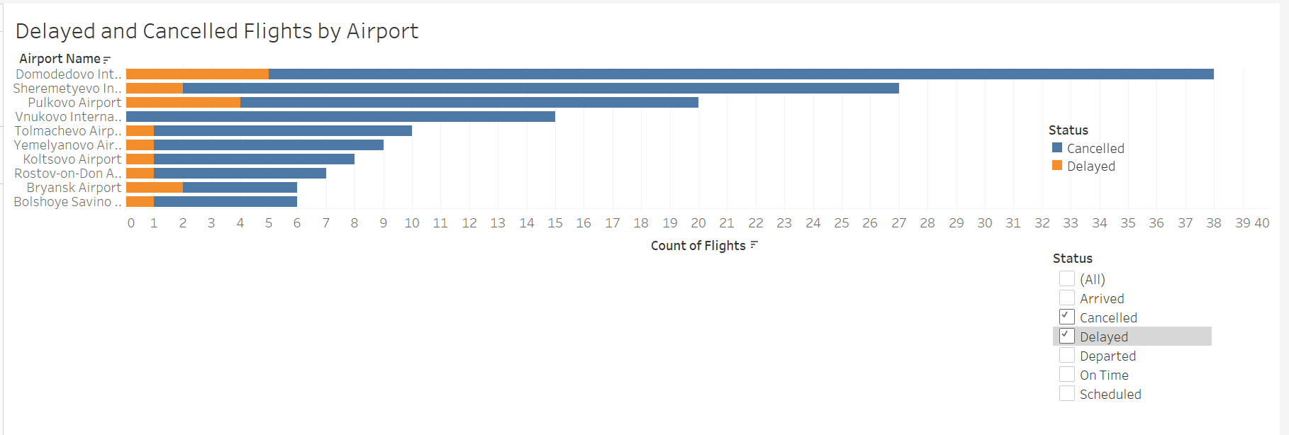
Business Use Case 2: Delay Analysis Insight
Introduction | EDA | ETL | Data Model | Revenue Analysis | Delay Analysis | Accident Analysis | Conclusion
DME and SVO airports have a higher chance of delay or cancellation.

Slide 29
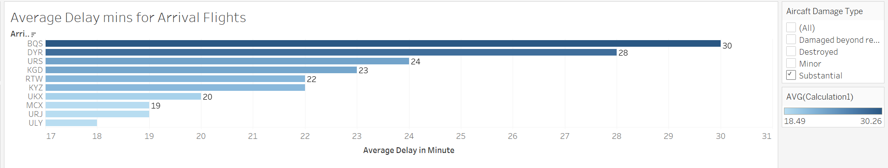
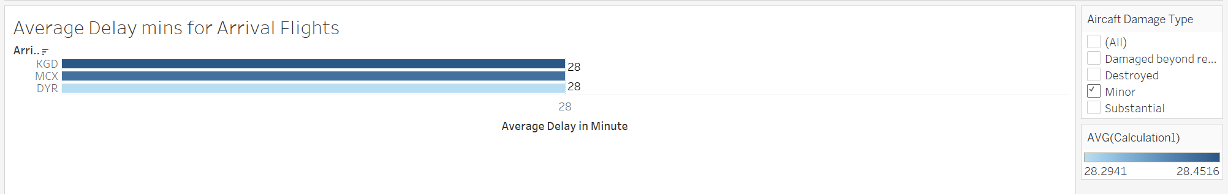
Business Use Case 2: Delay Analysis Insight
Introduction | EDA | ETL | Data Model | Revenue Analysis | Delay Analysis | Accident Analysis | Conclusion
It is reasonable that substantially damaged flights have longer delays than aircrafts that sustained minor damage.

Slide 30
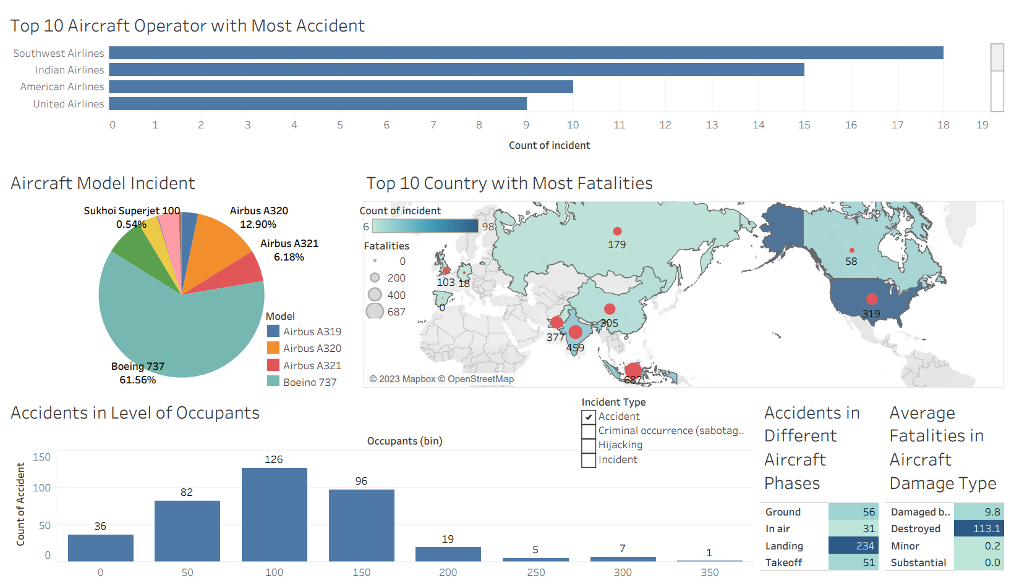
Business Use Case 3: Accident Analysis
Introduction | EDA | ETL | Data Model | Revenue Analysis | Delay Analysis | Accident Analysis | Conclusion

Slide 31
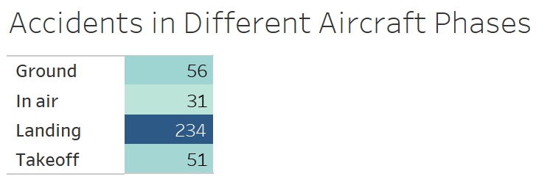
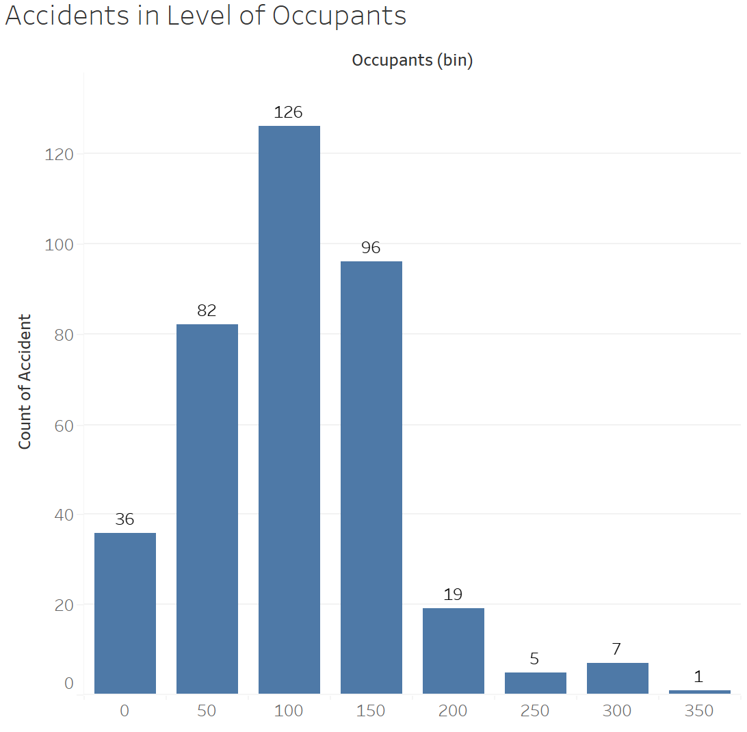
Business Use Case 3: Accident Analysis Insight
Introduction | EDA | ETL | Data Model | Revenue Analysis | Delay Analysis | Accident Analysis | Conclusion
Insight :
Most Aviation incidents happen during the Landing phase and Plane with smaller capacities tend to have a higher incident rate
Recommendation For Consumer:
Smaller planes have a higher incident rate, especially during the landing phase. Check aviation safety
records and try to choose larger planes if possible
Recommendation For Aviation Corporations:
Focus on training programs for pilots, especially emphasizing
the landing phase, continue monitor the accident record and
implement thorough maintenance schedule

Slide 32
Conclusion
Introduction | EDA | ETL | Data Model | Revenue Analysis | Delay Analysis | Accident Analysis | Conclusion
Operational Efficiency & Delays
Higher delay/cancellation rates at DME and SVO airports.
Insights support strategic decisions to enhance efficiency and reduce operational costs.
Revenue & Booking Trends
Significant revenue contributions from specific routes: Moscow to Novosibirsk
Larger aircraft models correlate with higher revenue: (Airbus A319, Boeing 767, Boeing 777)
Safety Analysis and Mitigation
Smaller planes have higher incident rate
Most incidents occur during landing, particularly with smaller aircraft.
Recommendations: Consumers to prefer larger aircraft; Airlines to focus on pilot landing training and rigorous safety protocols.

